Slide 1



Blowing up the bike shed with conventions
Jimmy Bogard
@jbogard
github.com/jbogard
jimmybogard.com

Slide 3
Parkinson’s Law of Triviality

Slide 4
Humans spend a great deal of time on trivial details while important matters are skipped

Slide 7
aka “Bikeshedding”

Slide 8
How do we bike shed?

Slide 9
We’re all guilty (yes you)
Class names
Class design
Folder structure
Patterns
HTML layouts
HTML widgets
Validation
SQL object names

Slide 10
These micro-decisions can derail projects!

Slide 11
Your opinion does not matter!

Slide 12
Consistency >>>>> your opinion

Slide 13
How do we enforce a standard?

Slide 14
Conventions!

Slide 15
What are conventions?

Slide 16
A set of coding policies applied and/or enforced across a codebase

Slide 17
Why should I care?

Slide 18
Survey of two projects
Project A
~6 years of development, 6-10 devs
>100 deployments to counties across Texas
ASP.NET MVC Preview 3 -> MVC 5
352 Controllers
1079 Actions
Project B
15 months of development, 6-10 devs
3 deployments to counties across Texas
78 Controllers
698 Actions

Slide 19
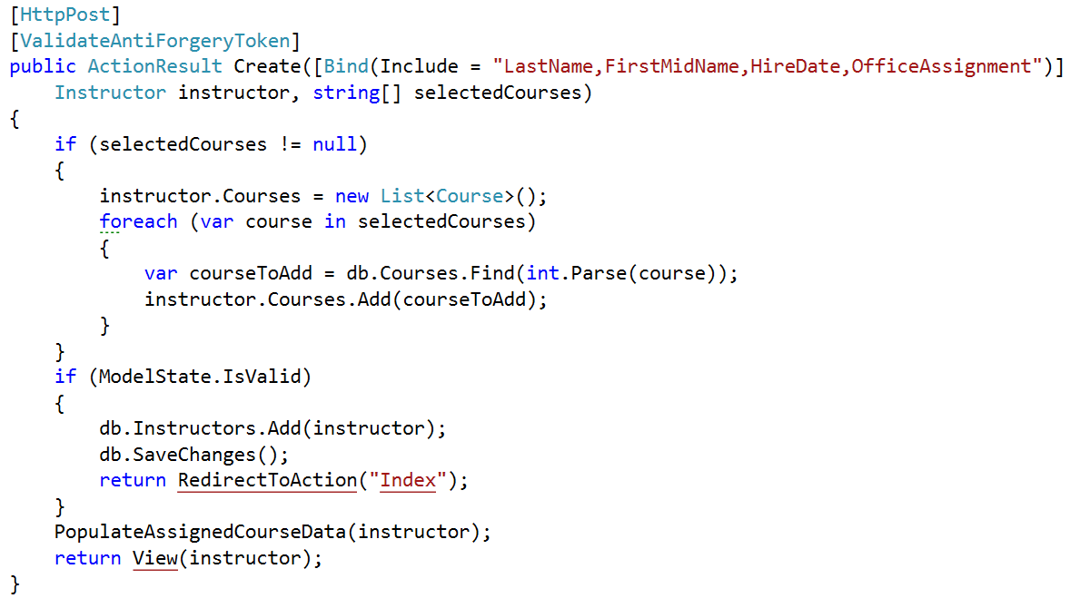
GETs/POSTs: Bad way

Slide 20
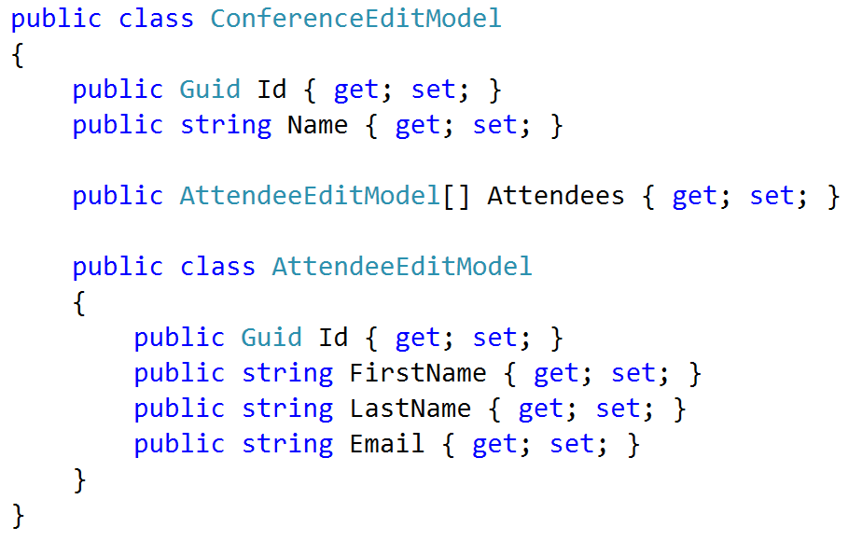
Cunning plan: View Models

Slide 21
Moment of panic
100s of controllers
100s of actions
100s of view models
100s of views

Slide 22


Slide 23
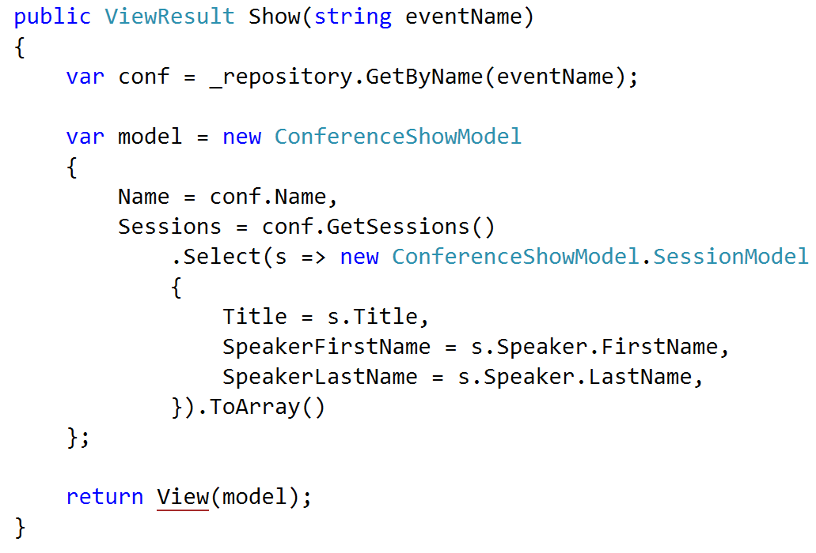
GET patterns

Slide 24
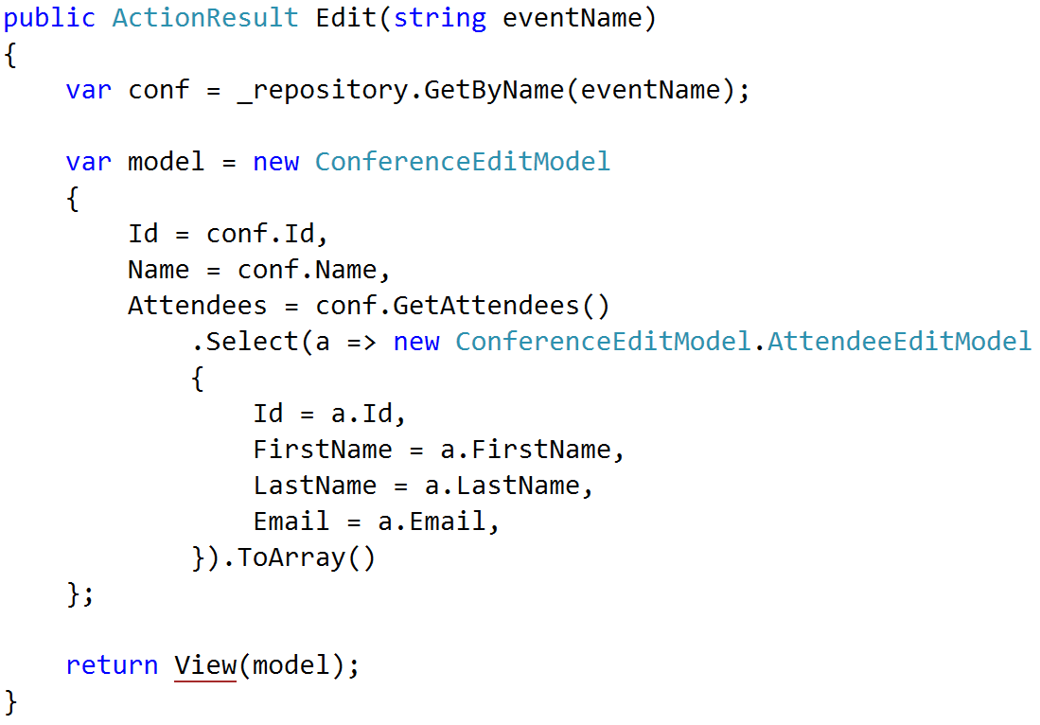
GET patterns

Slide 25
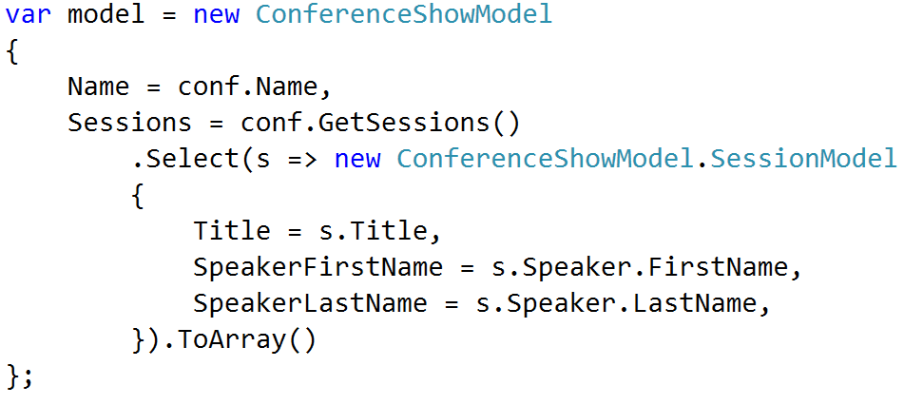
GET patterns ENHANCE

Slide 26
Policy
Match names exactly
Foo -> Foo
Bar -> Bar
Recognize Get methods
GetTotal() -> Total
Flatten navigations
Foo.Bar.Baz -> FooBarBaz
Handle the obvious

Slide 27
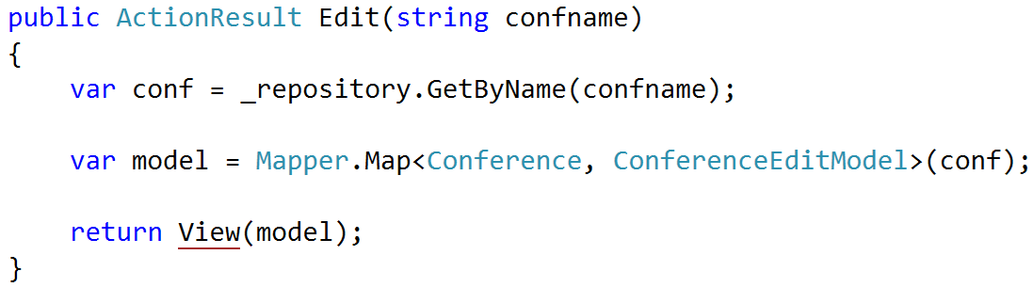
Result: AutoMapper

Slide 28
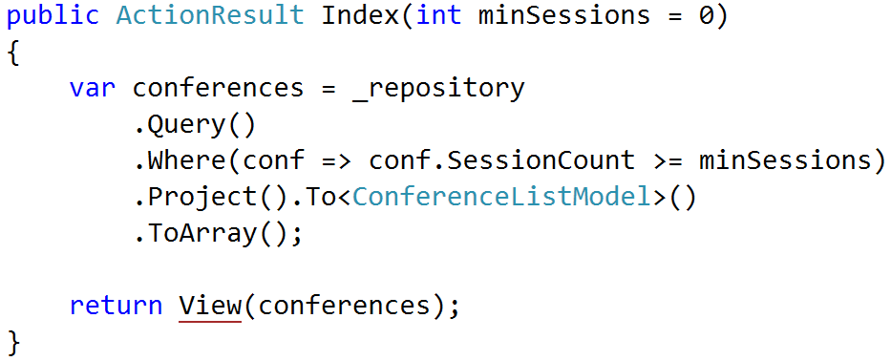
Result: AutoMapper

Slide 29
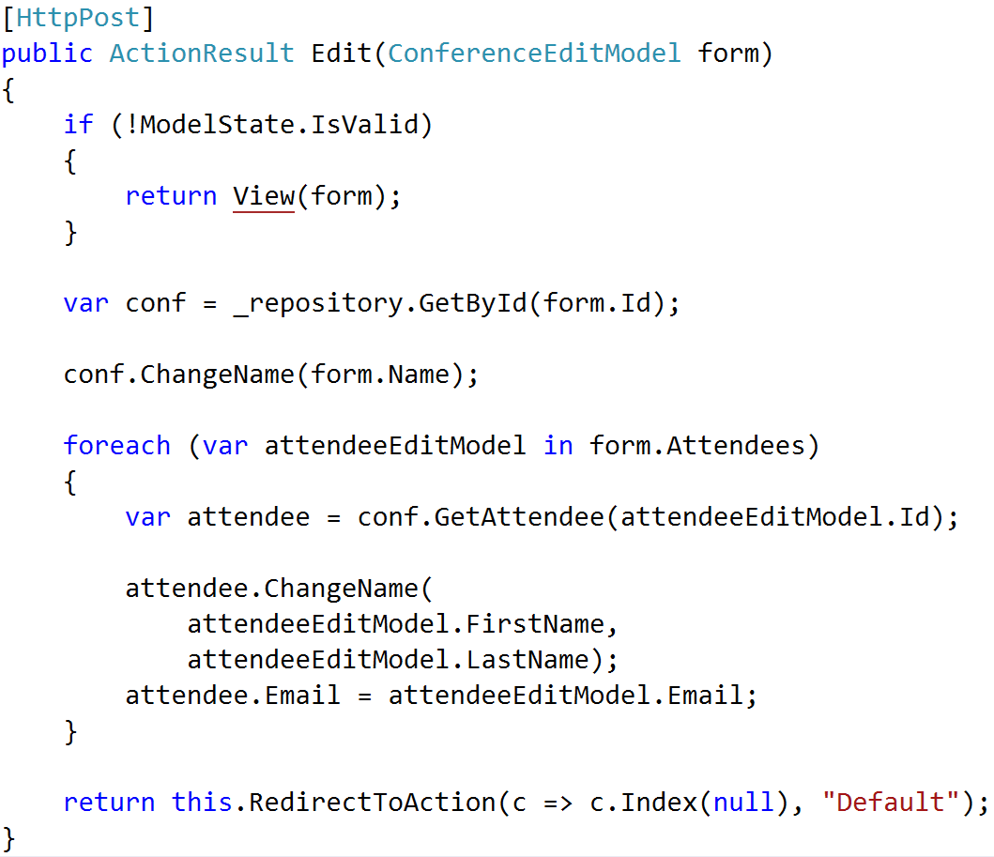
POST patterns

Slide 30
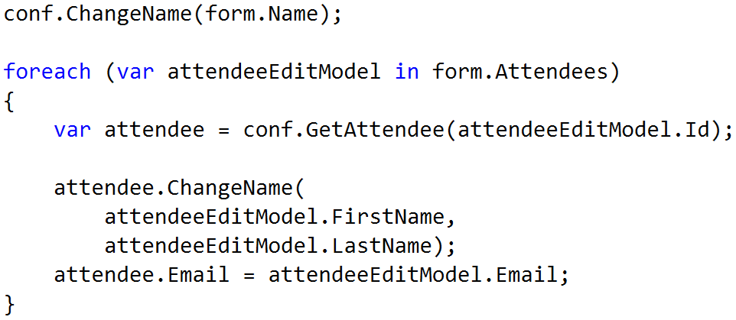
POST patterns ENHANCE

Slide 31
Policy
Behavioral entities
Logic much more complicated
No real patterns emerge
Leave it alone

Slide 32
Using Conventions

Slide 33
Implicit Conventions
Policy does not drive behavior
Policy enforced via rules
Similar to StyleCop, but one level up
Can use automated tests to enforce

Slide 34
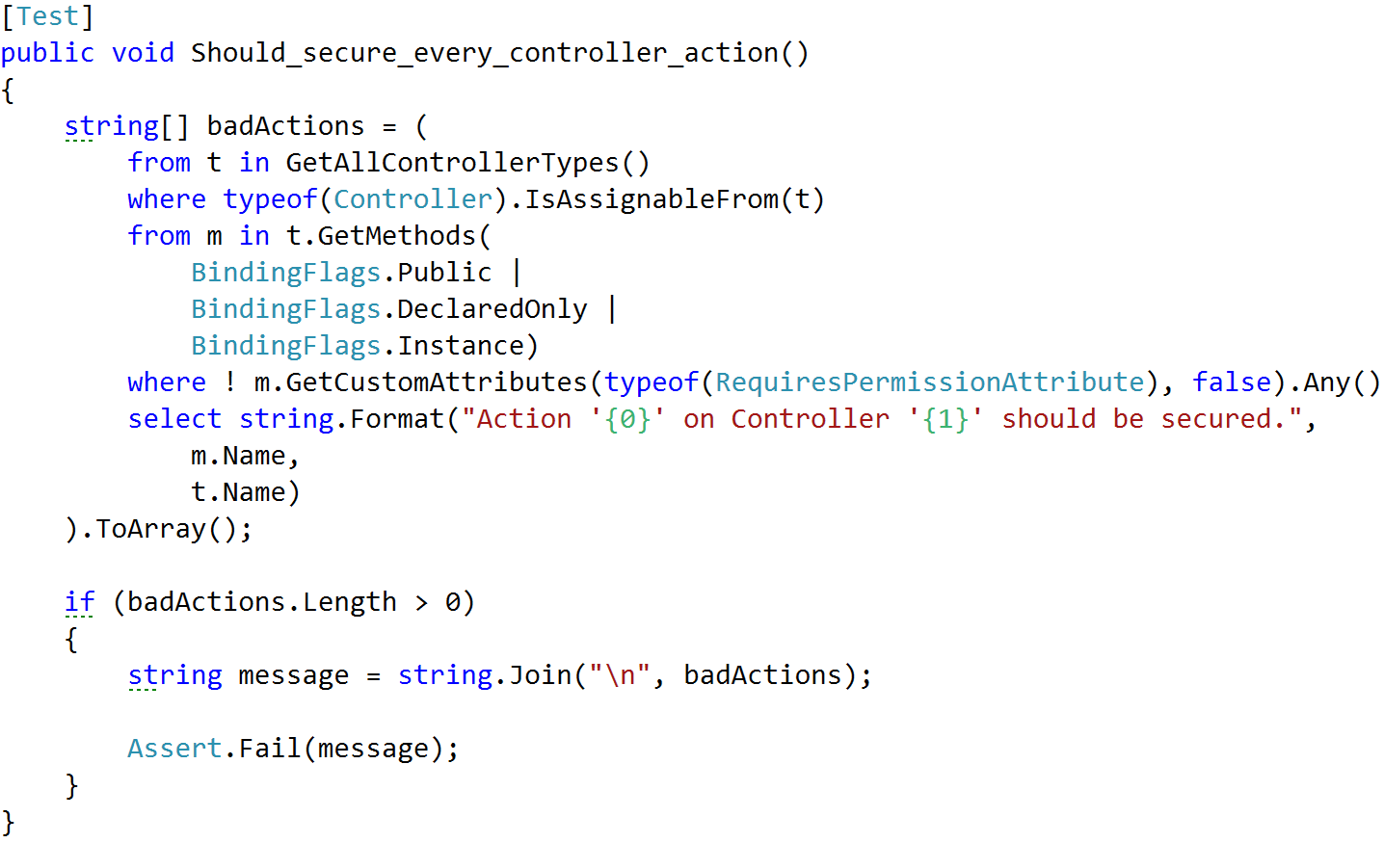
Example: Securing Actions

Slide 35
Other ideas
Type naming conventions
Controller/action names
Visibility rules
File organization

Slide 36
Explicit Conventions
Policy enforced by behavior
Opinionated rules
Customizable rules

Slide 37
Opinionated Conventions

Slide 38
Rule #1: Policies should be obvious, not magic

Slide 39
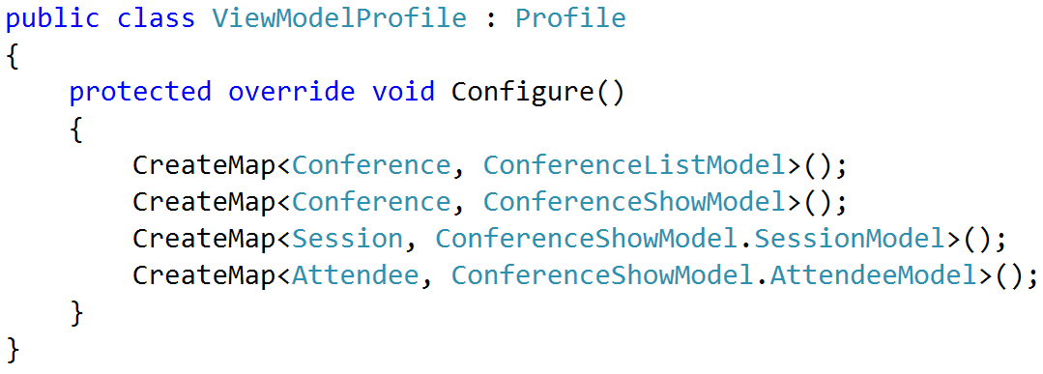
AutoMapper explicit config

Slide 40
Rule #2: Policies not driving behavior should be testable

Slide 41
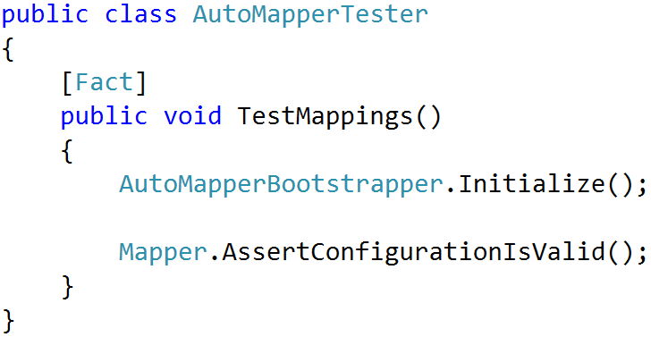
AutoMapper config validation

Slide 42
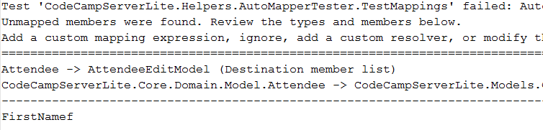
Rules violation

Slide 43
Rule #3: Policies should be debuggable

Slide 44
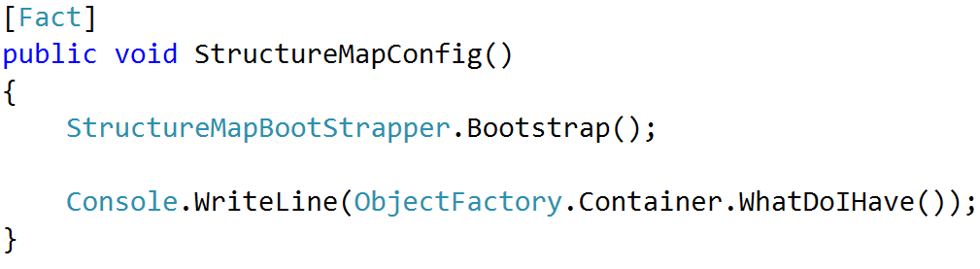
Examining StructureMap config

Slide 45
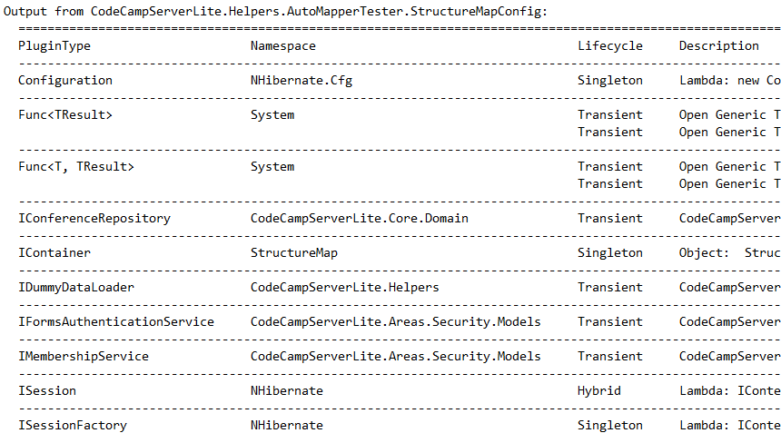
StructureMap config output

Slide 46
Real Example: HTML Conventions

Slide 47
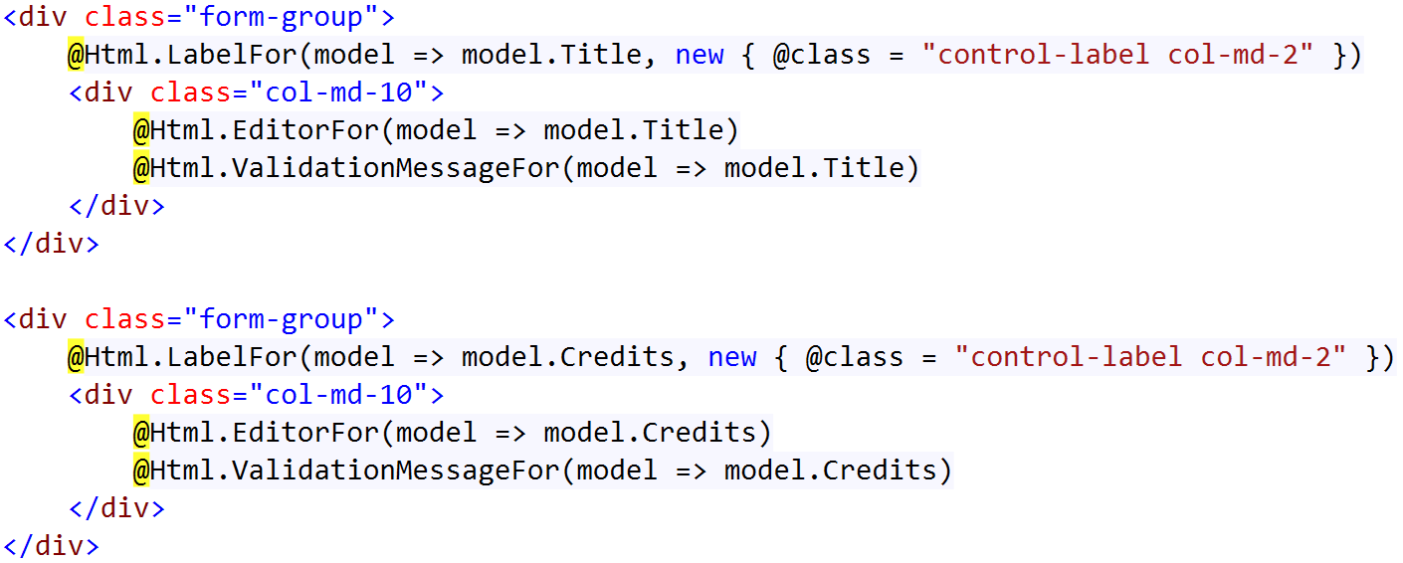
Problem: Dumb, repetitive code

Slide 48
Not a solution: templated helpers
Not easily composable
Not easily extensible
Not easily modifiable
Not code-centric

Slide 49
Solution: HTML Conventions
Element Request
Policies
Tag Model
String

Slide 50
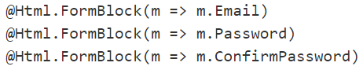
Goal

Slide 51
Tooling
Razor views
HtmlTag library for tag model
HtmlTag library for tag conventions

Slide 52
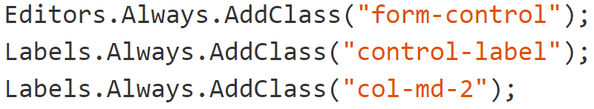
Establishing a baseline

Slide 53
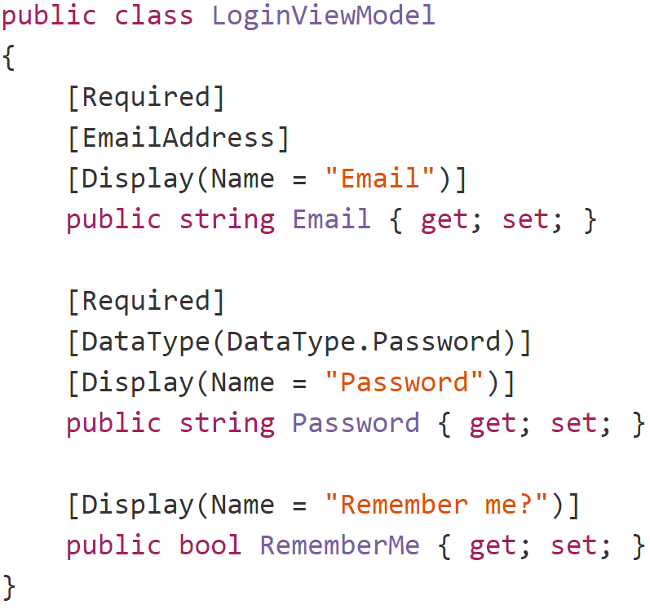
Sensible Defaults (Labels)

Slide 54
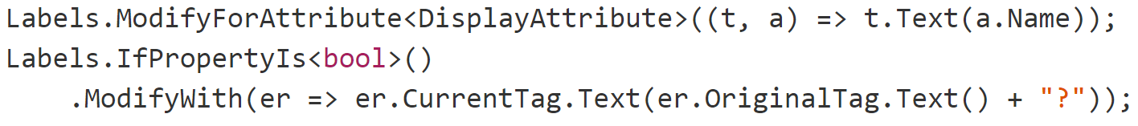
Sensible Defaults (Labels)

Slide 55
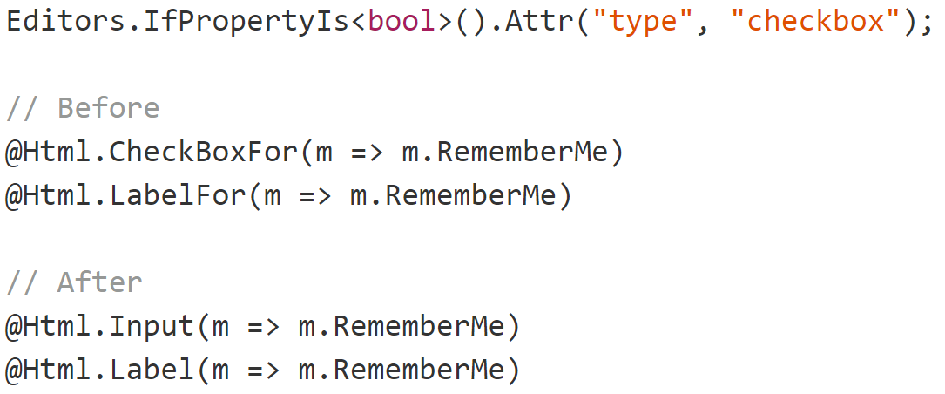
Sensible Defaults (inputs)

Slide 56
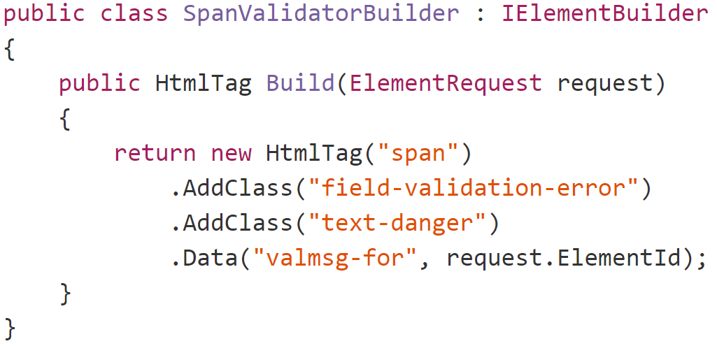
New Primitives (validation)

Slide 57
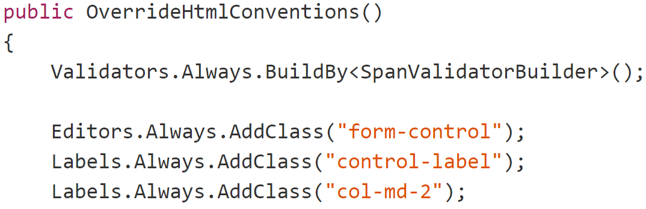
Building validators

Slide 58
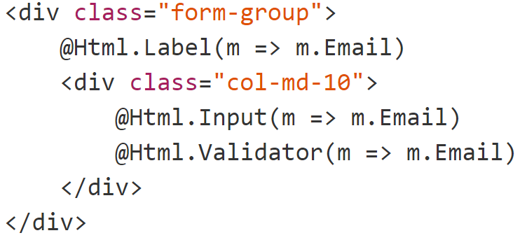
Labels, inputs and validators

Slide 59
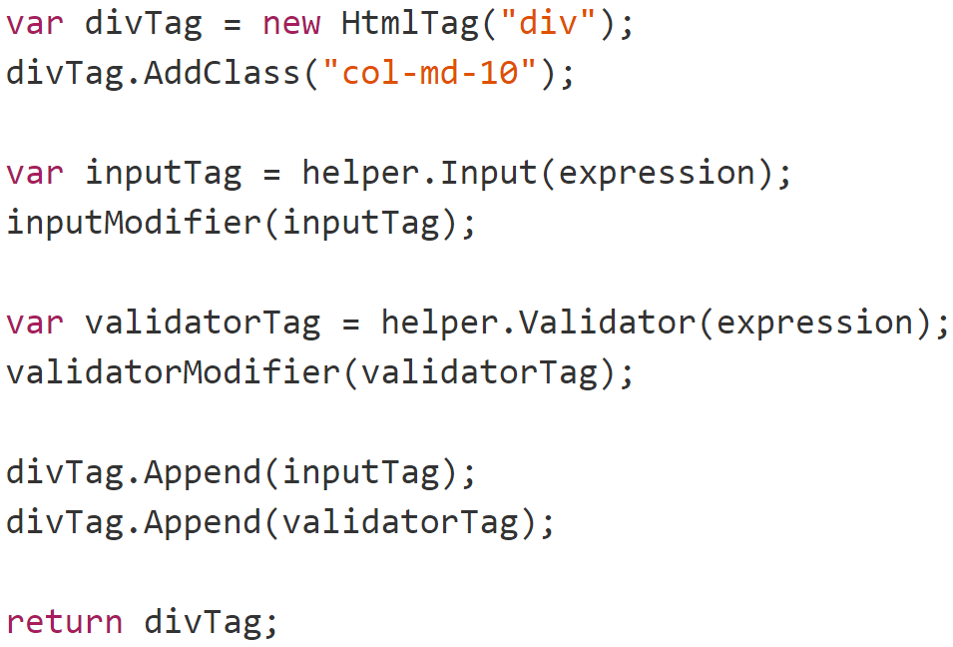
Larger primitives

Slide 60
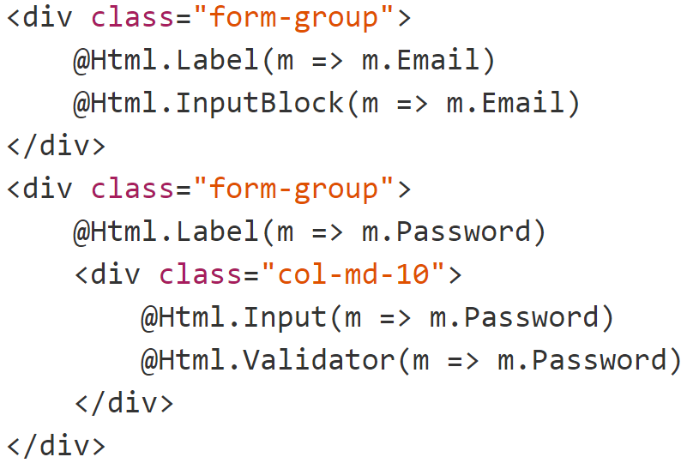
Larger primitives

Slide 61
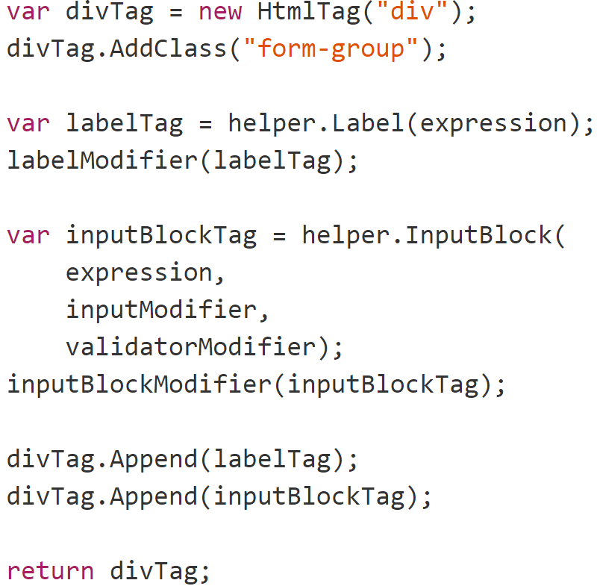
Final form

Slide 62
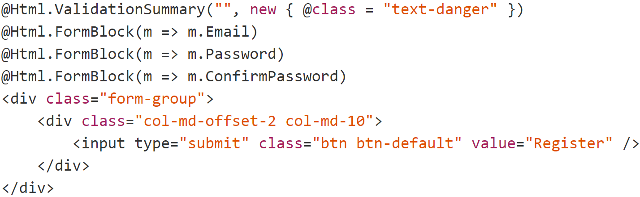
Final form

Slide 63
BUT WAIT I AM USING DURANDGULAREACT
(In which Jimmy gets sad)

Slide 64
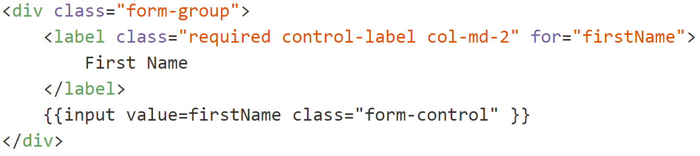
Back to the drawing board…

Slide 65
Problems
Browser
Server
POST
Rendering here
Metadata here
Templates, JS etc

Slide 66
Solution: Angularazor views
Razor View
Server
Razor Parser
Angular Component
Angular Binding
Client
Rendered HTML

Slide 67
Parting thoughts
Conventions = good
Magic = bad
Codegen is the devil

Slide 68
Blowing up the bike shed with conventions
Jimmy Bogard
@jbogard
github.com/jbogard
jimmybogard.com

